Slide 1
Bazele inteligenței artificiale
Laborator – Grigore Ionuț

Slide 2

today’s lab

Slide 3
Content
Decision trees
Voting
Bagging and pasting
Random forests
Boosting

Slide 4
1) Decision trees

Slide 5
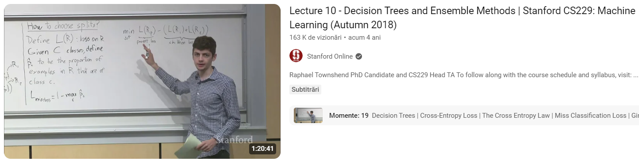
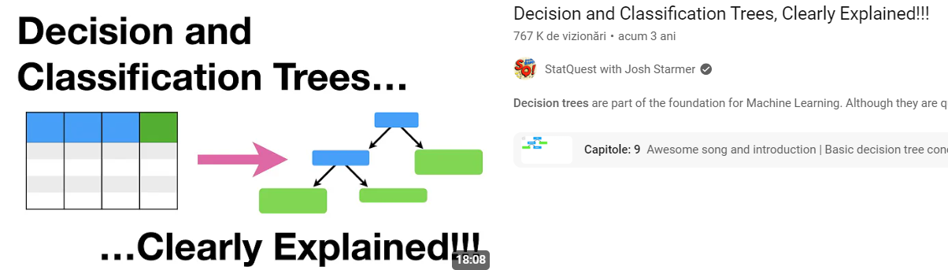

Slide 6
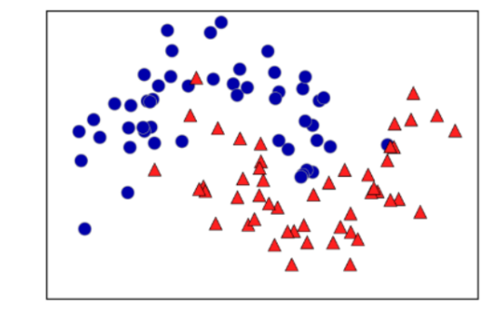
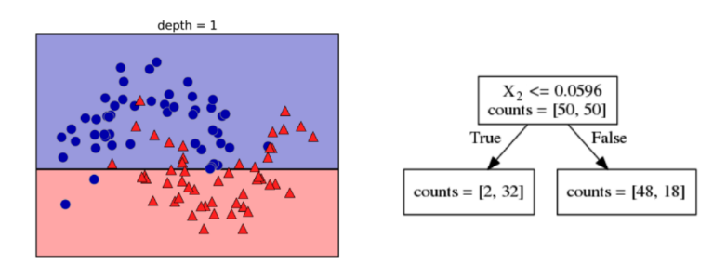
X₂
X₂
X₁
X₁

Slide 7
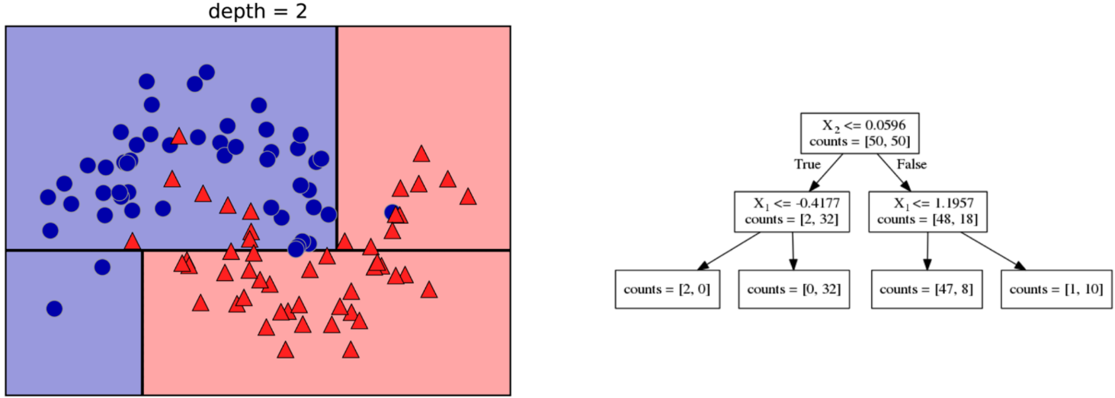
X₂
X₂
X₁
X₁

Slide 8


Slide 9
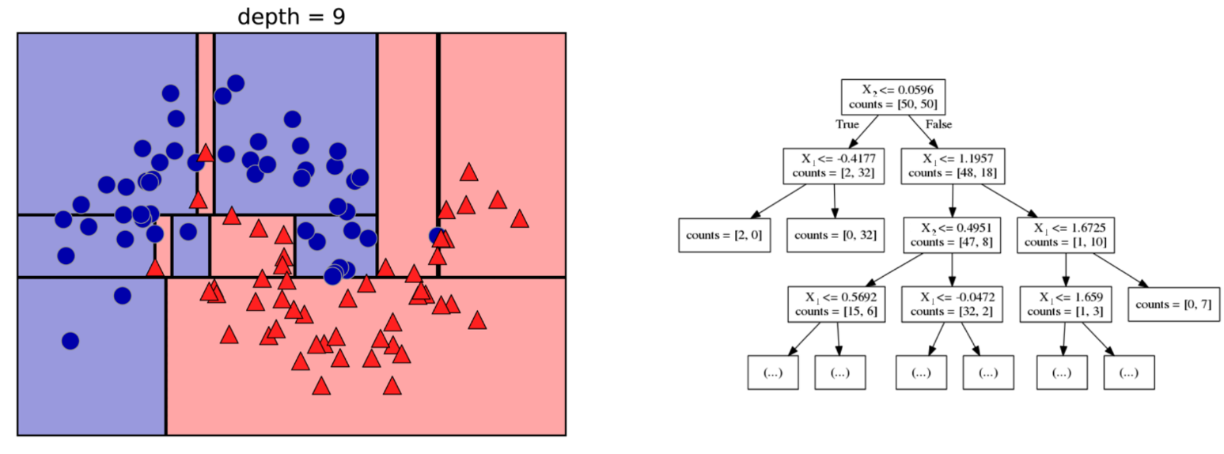
X₂
X₂
X₁
X₁

Slide 10
Then what ?

Slide 11
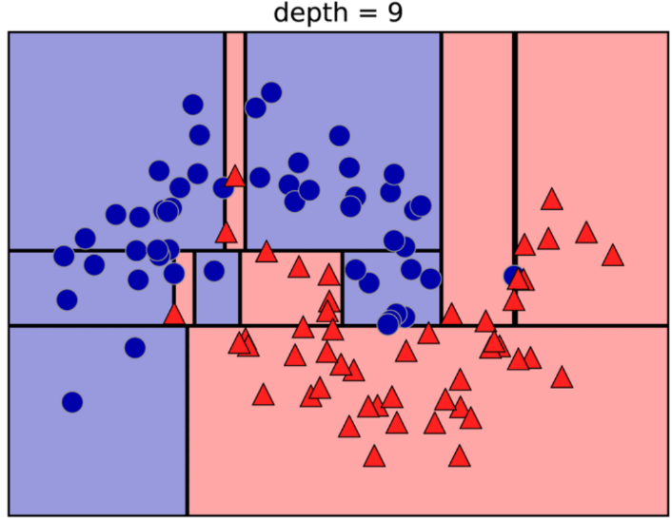
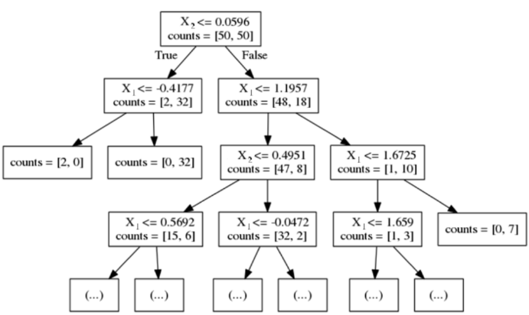
The yellow test point traverses the tree from the root to the leaves…
classification blue
regression the mean of the 2 blue points
classification red
regression the mean of the 33 red points

Slide 12
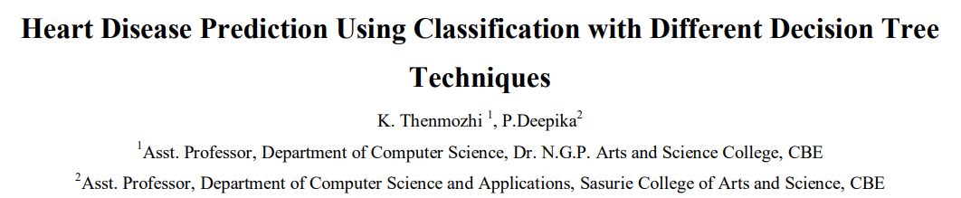
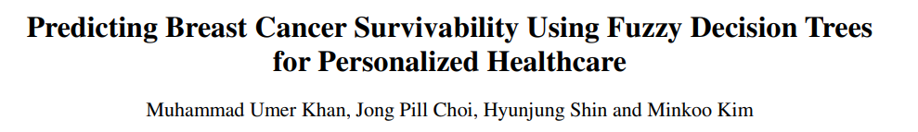

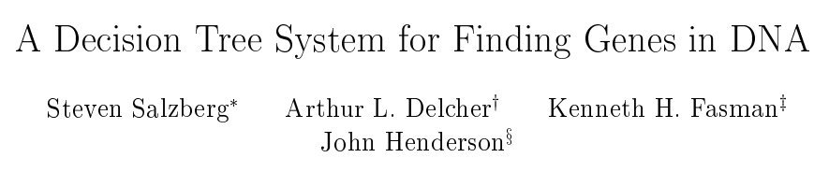
Some real-world use case examples…

Slide 13
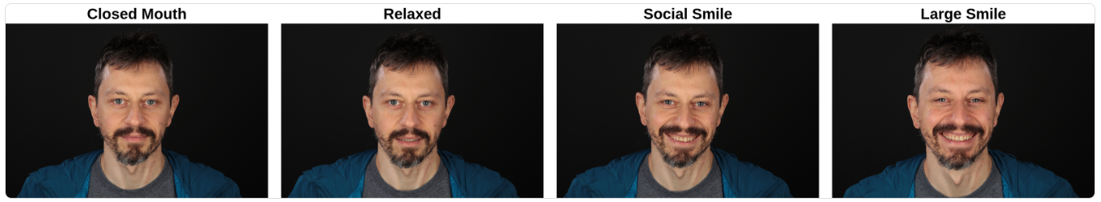
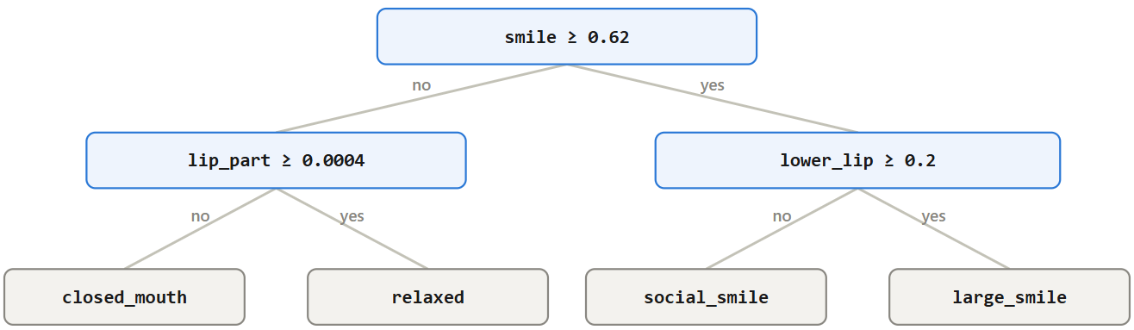

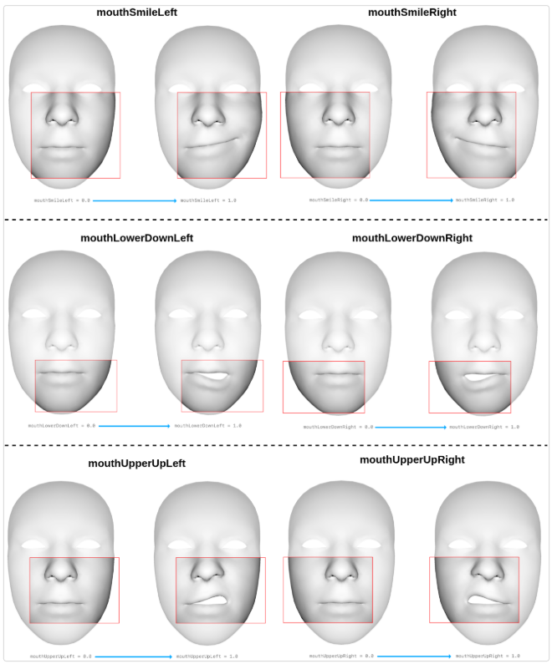
Google MediaPipe:

Slide 14
Code part

Slide 15
Classification

Slide 16

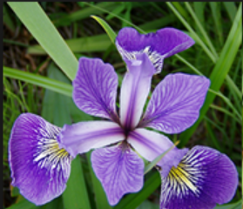
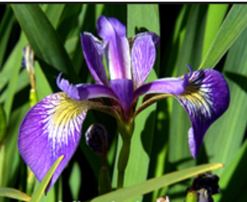
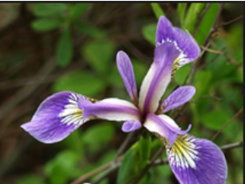
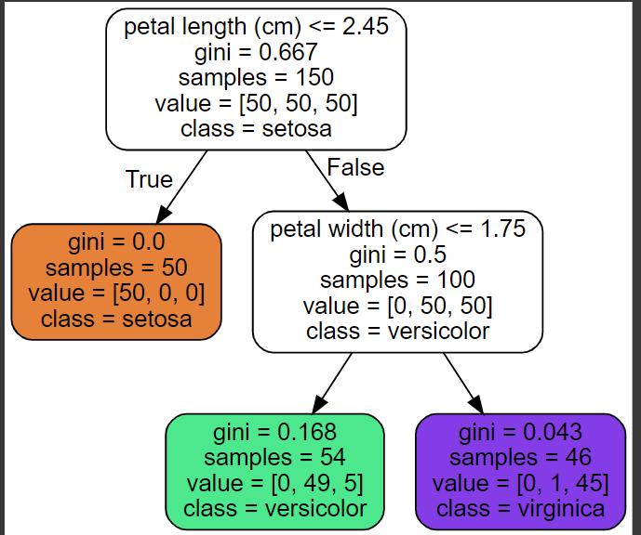
versicolor
setosa
virginica
ML/DL
model
based on:
petal width
petal length
Decision Tree

Slide 17
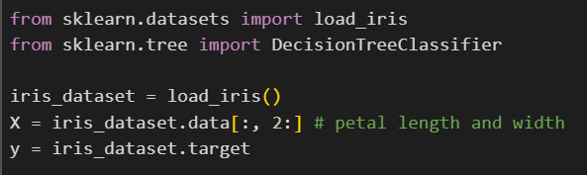
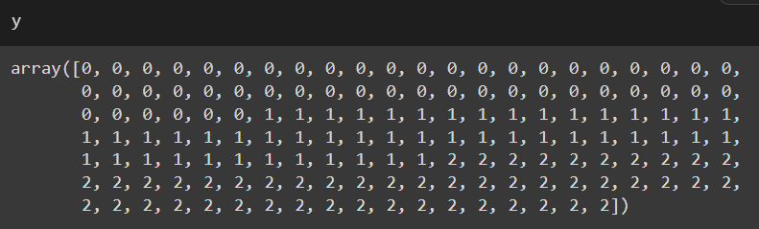
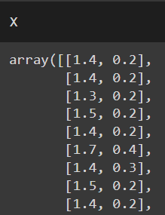
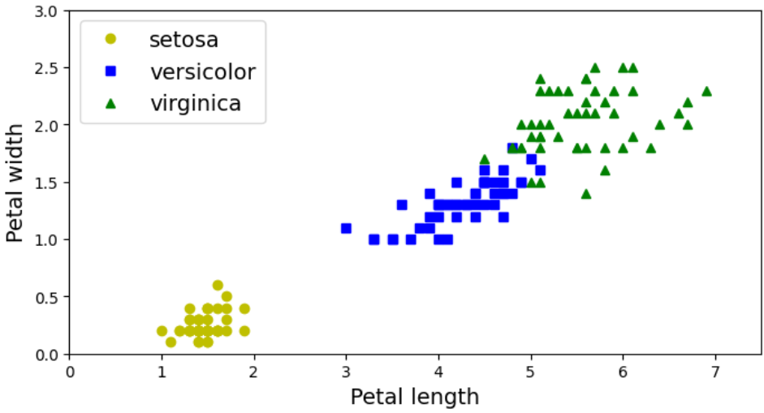
…

Slide 18
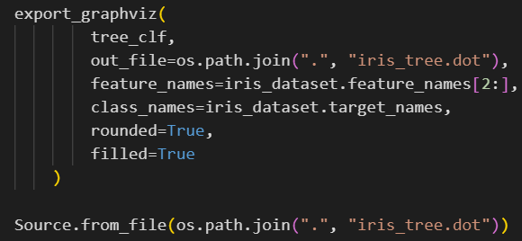

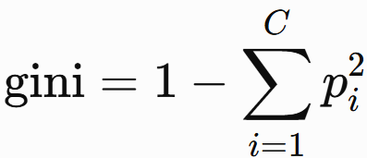

gini = impurity of the node
a node is pure (gini = 0.0) if every point in the node belongs to the exact same class
, where:
  C = total number of classes
.

Slide 19
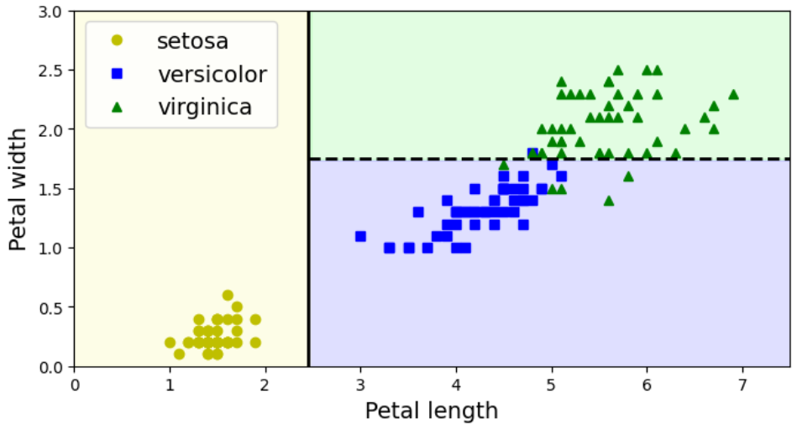
plot_decision_boundary() function from lab
1.75
2.45

Slide 20


Prediction:
iris versicolor (class 1) because it has the highest probability

Slide 21
Regression

Slide 22
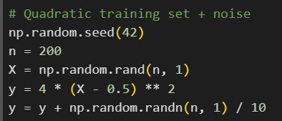
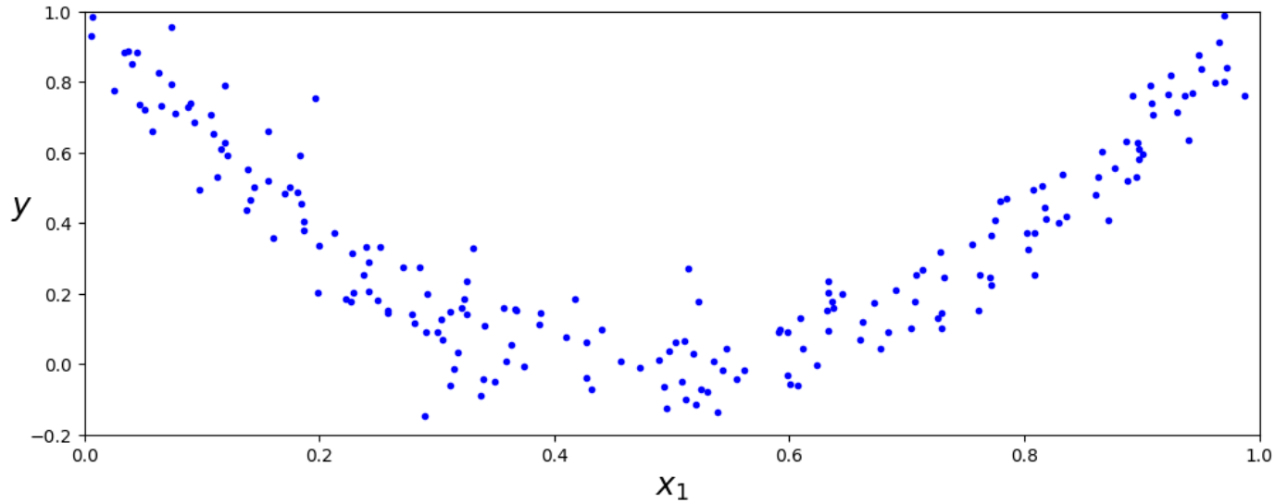

Slide 23
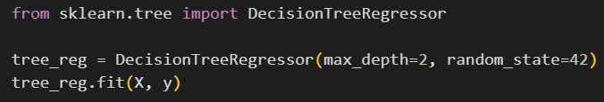
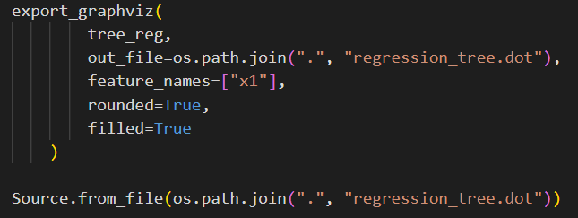
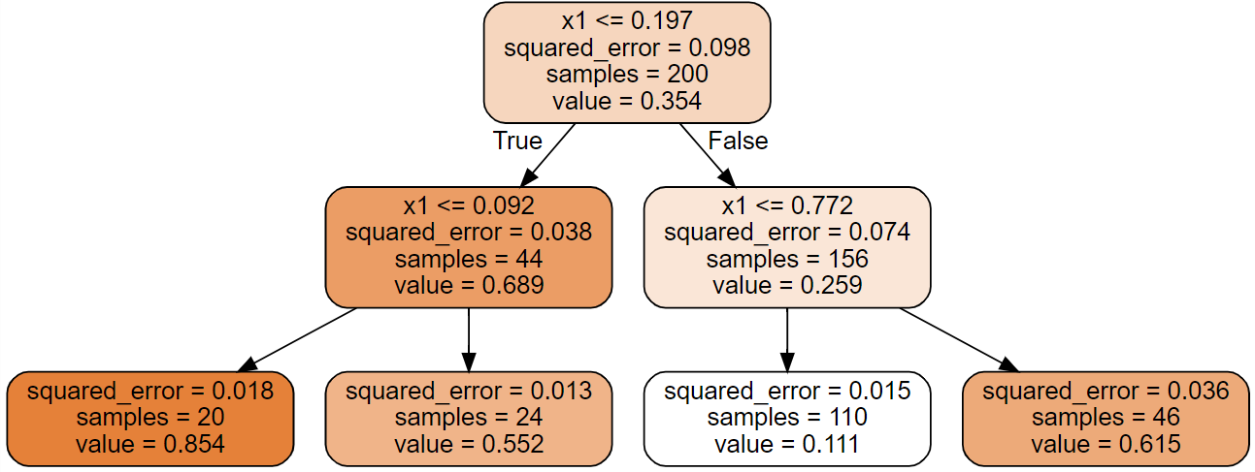

Slide 24
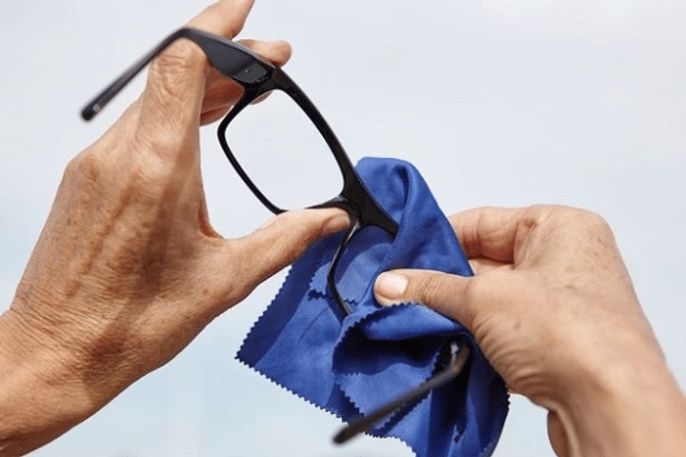

Slide 25
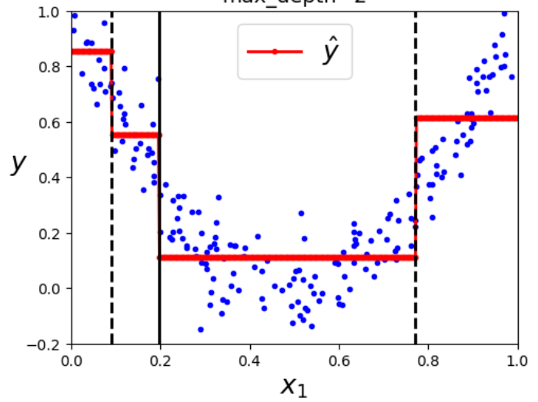

Slide 26
2) Voting

Slide 27

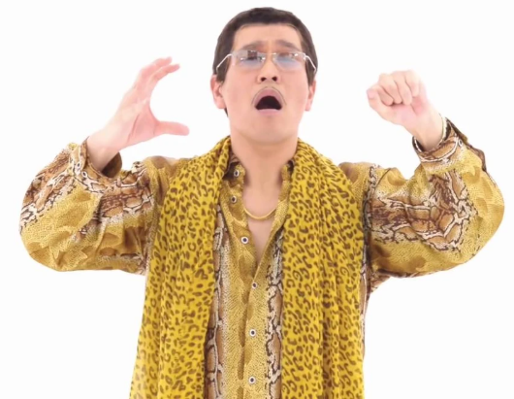




ensemble = group of combined predictors (classifiers or regressors)
Predictor 1
Predictor 3
Predictor 2
Predictor 4
…
…

Slide 28
“If you aggregate the predictions of a group of predictors (classifiers or regressors), you will often get better predictions than with the best individual predictor.”

Slide 29
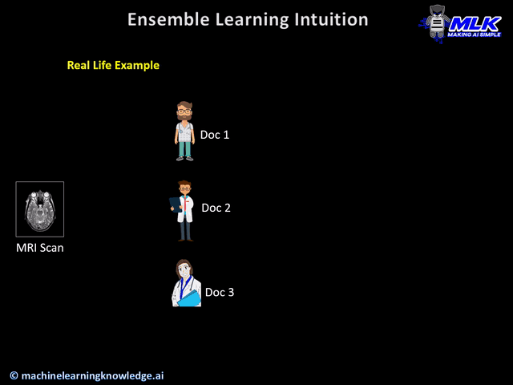

Slide 30
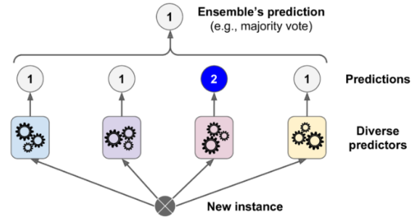

hard voting classifier Predicts the class with the majority of votes.
soft voting classifier Predicts the class with the highest average probability across all models.
Ensemble’s prediction
Predictions
Diverse predictors
New instance
Ensemble’s prediction
1 – 70%
2 – 30%
Average
1 – 70%
2 – 30%
1 – 40%
2 – 60%
1 – 90%
2 – 10%
1 – 80%
2 – 20%
Predictions
Diverse predictors
New instance

Slide 31


Slide 32
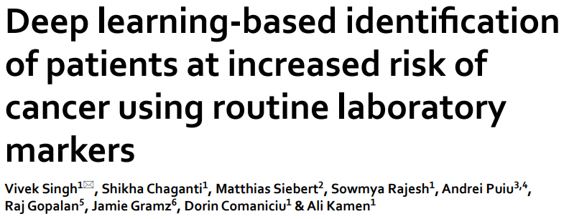
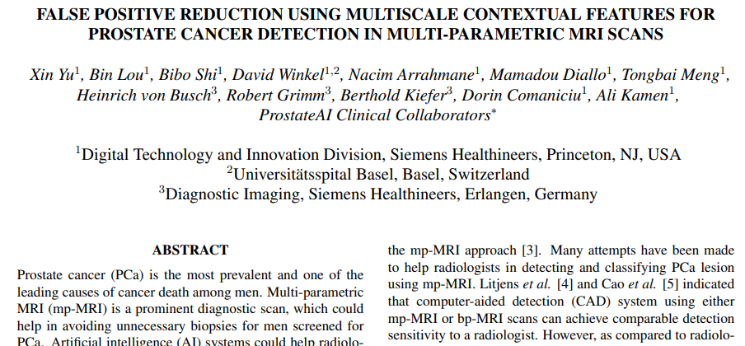
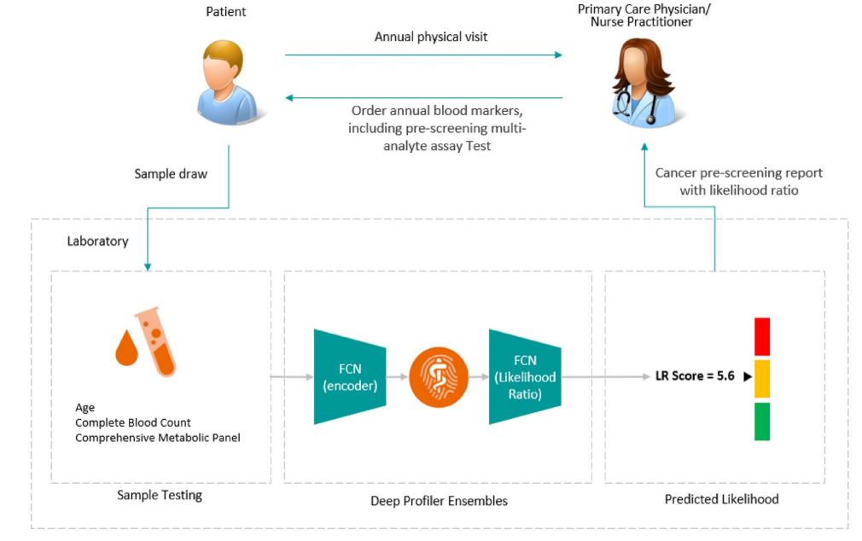
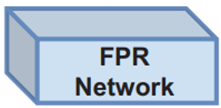
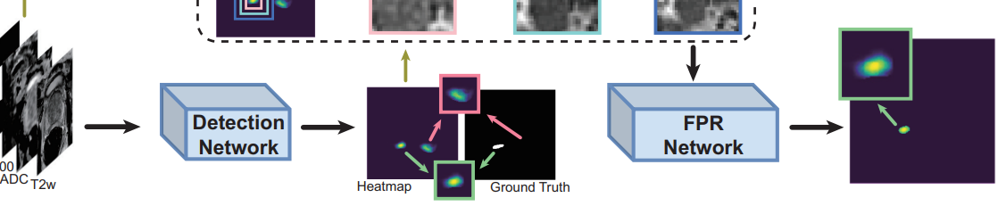


Examples from Previous Work…
…
Ensemble of models

Slide 33
Code part

Slide 34
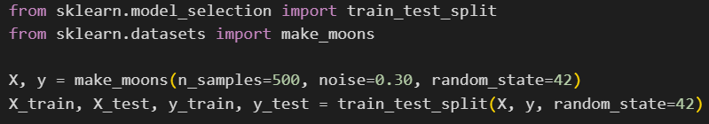
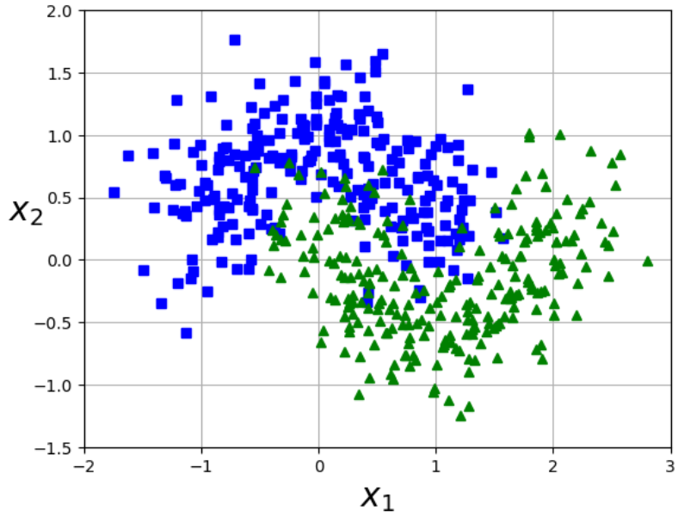
plot_dataset() function from lab 3 ☺

Slide 35
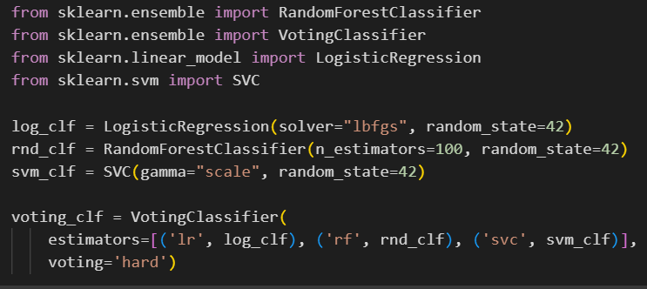

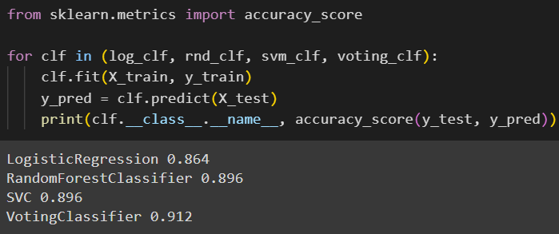

Hard voting

Slide 36
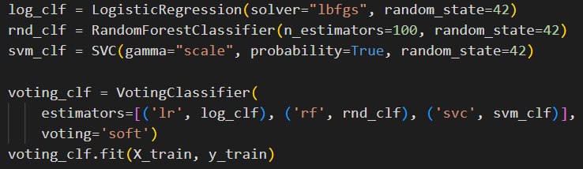
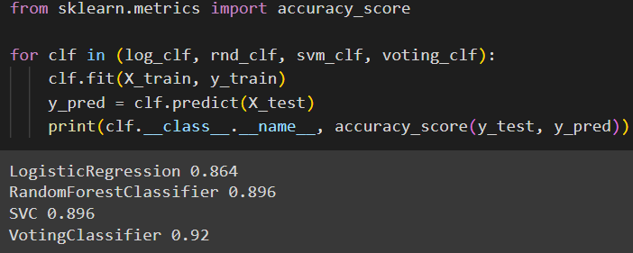

Soft voting

Slide 37
3) Bagging and pasting

Slide 38

train the same algorithm on different random subsets of the training data
when sampling is performed with replacement bagging
when sampling is performed without replacement pasting
predict by aggregating the outputs of all trained models
often called bootstrap

Slide 39
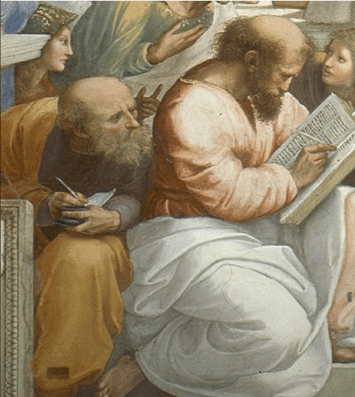
Life is better with an example…

Slide 40
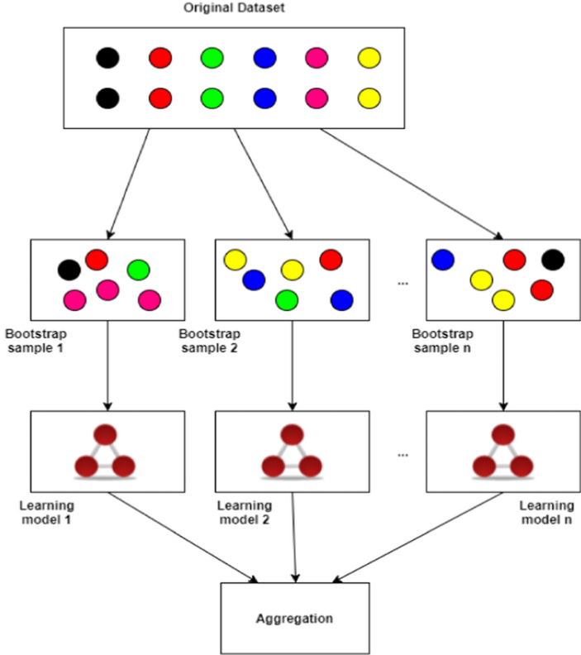
training set
training set
bagging
pasting
subset 1
subset 2
subset n
subset 1
subset 2
subset n
model 1
model 2
model n
model 1
model 2
model n
aggregation
aggregation
suppose you have a dataset with 12 points
for each model, you want to draw 6 random samples from these 12 points.
if you're sampling with replacement, then for each model:
  randomly select a data point from the 12 data points.
  record that selection, but then put that data point back into the pool of 12 data points, so it can be selected again.
  repeat this process 6 times.
suppose you have a dataset with 12 points
for each model, you want to draw 6 random samples from these 12 points.
if you're sampling without replacement, then for each model:
  randomly select a data point from the 12 data points.
  record that selection, but do not put that data point back
into the pool of 12 data points, so it can’t be selected again.
3.repeat this process 6 times.

Slide 41
Benefits ?

Slide 42
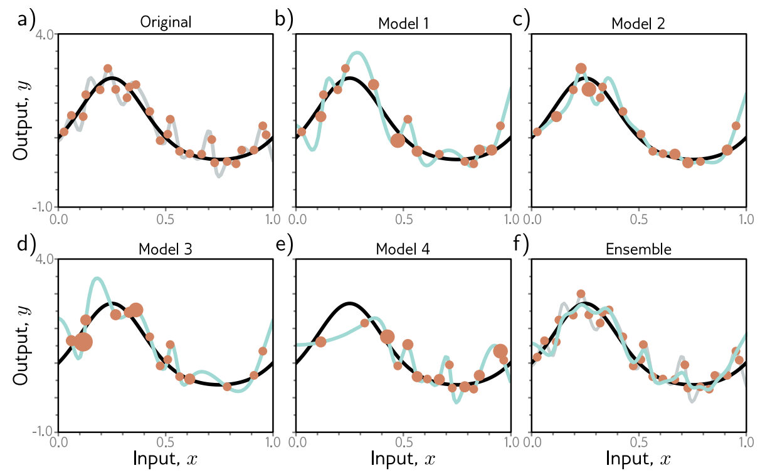

much better☺
Averaging multiple models can reduce overfitting, leading to smoother and more stable predictions!

Slide 43
Code part

Slide 44
plot_dataset() function from lab 3 ☺

Slide 45
Bagging

Slide 46
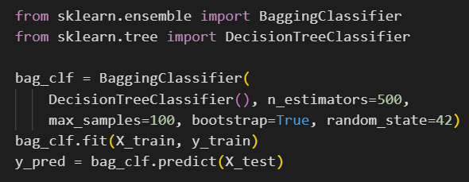


use an ensemble of 500 decision tree
each decision tree is trained on 100 training instances
the 100 training instances are randomly sampled from the training set with replacement bagging
accuracy for a single decision tree classifier:
accuracy for the bagging classifier:

Slide 47

plot_decision_boundary() function from lab

Slide 48
Pasting

Slide 49

use an ensemble of 500 decision trees
each decision tree is trained on 100 training instances
the 100 training instances are randomly sampled from the training set without replacement pasting
accuracy for a single decision tree classifier:
accuracy for the pasting classifier:

Slide 50

plot_decision_boundary() function from lab

Slide 51
4) Random forests

Slide 52


Slide 53


random forest = ensemble of decision trees

Slide 54
Code part

Slide 55


don’t worry about them ☺

Slide 56
5) Boosting

Slide 57



Slide 58


Boosting: Trains models sequentially, each correcting the predecessor's mistakes.
1) AdaBoost: Focuses on the instances the previous model underfitted.
2) Gradient Boosting: Fits directly to the previous model's residual errors.

Slide 59

AdaBoost steps:
train an initial base classifier (e.g., a decision tree)
increase the weights of misclassified instances
train the next classifier on the updated weights, and repeat

Slide 60


Slide 61

Ideea de bază:
În loc să dăm aceeași importanță tuturor exemplelor, AdaBoost mărește ponderea celor clasificate greșit — ca următorul model să fie mai atent la ele.
Pași:
🔹 Antrenăm primul clasificator pe toate exemplele (cu ponderi egale).
🔹 Vedem ce exemple a greșit și le creștem ponderea.
🔹 Antrenăm un al doilea clasificator — acesta acordă mai multă atenție exemplelor dificile.
🔹 Repetăm procesul (ajustăm ponderi, antrenăm noi modele).
🔹 Predicția finală = combinația ponderată a tuturor clasificatorilor.

Slide 62
Gradient Boosting steps:
consider a regression problem where we use decision trees as predictors
train Tree 1 on the training data
train Tree 2 on Tree 1's residual errors
train Tree 3 on Tree 2's residual errors.
for prediction, sum the outputs of all 3 trees

Slide 63
Ideea de bază:
În loc să antrenăm un singur model mare, antrenăm o serie de arbori care învață reziduurile (adică erorile rămase) de la pașii precedenți.
Pași:
🔹 Antrenăm primul arbore pe datele originale (X, y).
🔹 Calculăm reziduurile = valoarea reală – predicția arborelui.
🔹 Antrenăm al doilea arbore să prezică aceste reziduuri.
🔹 Calculăm din nou reziduurile (ce nu a reușit să repare al doilea arbore).
🔹 Repetăm procesul pentru mai mulți arbori.
🔹 Predicția finală = suma tuturor predicțiilor (fiecare arbore contribuie puțin).

Slide 64




^
^
^
^
-1
original training set

Slide 65




Slide 66




Slide 67
Code part

Slide 68
AdaBoost

Slide 69
plot_dataset() function from lab 3 ☺

Slide 70


plot_decision_boundary() function from lab

Slide 71
Gradient Boosting

Slide 72



Slide 73




1)
Train Tree 1 on the training data.
2)
Train Tree 2 on Tree 1's residual errors
3)
Train Tree 3 on Tree 2's residual errors.
4)
Predict: Sum the outputs of all 3 trees.

Slide 74


…or in a simpler way…
plot_predictions() function from lab

Slide 75


Decision trees: learn by asking if/else questions to split data into leaf nodes.
  Classification: predict the majority class in each leaf.
  Regression: predict the mean value in each leaf.

Slide 76
Voting (Ensemble of Models): combine multiple classifiers/regressors for better accuracy.
  Hard Voting: majority vote of class predictions.
  Soft Voting: average class probabilities and choose the highest.
Ensemble’s prediction
1 – 70%
2 – 30%
Average
Ensemble’s prediction
1 – 70%
2 – 30%
1 – 40%
2 – 60%
1 – 90%
2 – 10%
1 – 80%
2 – 20%
Predictions
Predictions
Diverse predictors
Diverse predictors
New instance
New instance

Slide 77
Bagging and pasting: train same model on random subsets of the data:
  Bagging: with replacement
  Pasting: without replacement.
subset 1
subset 2
subset n
subset 1
subset 2
subset n
model 1
model 2
model n
model 1
model 2
model n
aggregation
aggregation

Slide 78
Random Forests: Ensemble of Decision Trees.

Slide 79

Boosting: train models sequentially, each correcting previous errors.
  AdaBoost: focus more on misclassified samples.
  Gradient Boosting: fit new models to residual errors.

Slide 80


Slide 81
Exercises

Slide 82


Slide 83
Big picture first, details last

Slide 84



Solutions

Slide 85



Slide 86



Slide 87


NOTE: this is how you can import and use digits dataset !

Slide 88



OPTIONAL: plotting some examples to understand the data you use ☺

Slide 89



Slide 90




Slide 91


Slide 92



Slide 93
Thank you !

